Slide 1
DIALYSIS ADEQUACY
Hafez Bazaraa

Slide 2
Case #1
M.H. is 6 y old (16Kg) on regular HD.
Predialysis serum creatinine is 5mg/dL, Urea 80 mg/dL, Bicarbonate 21 mmol/L, Hb 8
and postdialysis urea 35 mg/dL.
The father is insisting the child is now better and it is in his best interest to shorten dialysis from 4 to 3 hrs.
Do you agree?

Slide 3
Whenever dialysis is indicated,
the patient should receive ADEQUATE DIALYSIS
How would you define, based on
intent of REPLACING RENAL FUNCTIONS?

Slide 4
The start ….
Kolff, a Dutch physician constructed the first working dialyzer in 1943 during the Nazi occupation of the Netherlands
Using sausage casings, beverage cans, a washing machine, and other items
16 patients with ARF unsuccessfully treated
In 1945, a 67-year-old comatose woman regained consciousness following 11 hours of HD and lived 7 yrs before dying from an unrelated condition.

Slide 5
The start …
A desperate attempt to rescue
VA largely acute non-renewable; using intra-arterial rigid devices
The kidney has been the first solid organ whose function was approximated by a synthetic device
And is so far the ONLY for long-term replacement

Slide 6
Whenever dialysis is indicated,
the patient should receive ADEQUATE DIALYSIS for
GOAL
Survival
Minimizing morbidity
Quality of life
Given the effect of dialysis itself on these !!!

Slide 7
What constitutes adequate dialysis?
Can we measure dialysis?

Slide 8
What constitutes adequate dialysis?
Can we measure dialysis?
Measurements related to native KF
Urea and creatinine
Common, yet far from ideal !!!
Clearance
Extent of removal independent of level

Slide 9
Frank Gotch introduced the concept of adequacy of dialysis
when he proposed the ‘Urea Clearance’ concept
as a measure of dialysis efficacy

Slide 10
KT/V: HD Clearance Concept
KT/V (urea) is the fractional urea clearance per session
KT= volume of blood cleared during session
V= total volume of distribution of urea (=TBW)
UREA: easily diffusible, easily measurable, evenly distributed over TBW

Slide 11
The ‘very’ basic concept
Blood passing through the dialyser is cleared
So blood flow x time is the amount cleared
KT/V =1 is when that volume equals patient TBW
10 Kg; V=6000 mL
Cl 50 mL/min x 120 min = 6000 mL; KT/V=1

Slide 12
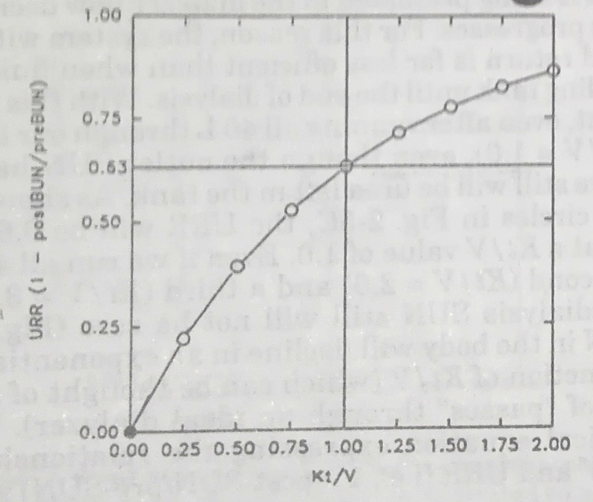
The ‘very’ basic concept
ISSUE#1/2
Plasma solute concentration decreases fairly rapidly during dialysis
Because dialysed blood is returned to patient !!!
So KT/V of 1.00 removes only 63% of solute

Slide 13
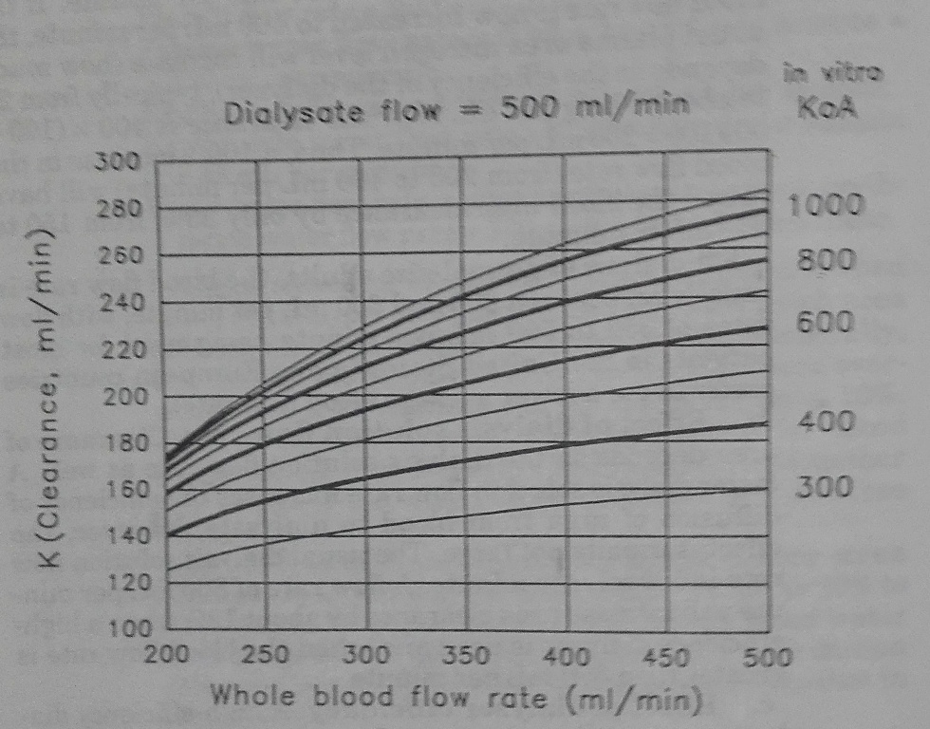
The ‘very’ basic concept
ISSUE#2/2
Post-dialyser urea is very low BUT NOT ZERO
So NOT ALL blood flowing is cleared
K ≠ flow, but depends also on
Dialyser size & clearance (KoA)
Blood flow relative to dialyser size
Dialysate flow

Slide 14
How KT/V is calculated
From URR
KT/v= -In(1-URR)

Slide 15
How KT/V is calculated
From URR
KT/v= -In(1-URR)
Corrected for uF & Urea generation
Daugirdas (1995) natural logarithm formula
KT/v= -In(R-0.008xt)+(4-3.5xR)x0.55UF/V
Where R=1-URR or post/pre urea
The machine can do it !!!!

Slide 16
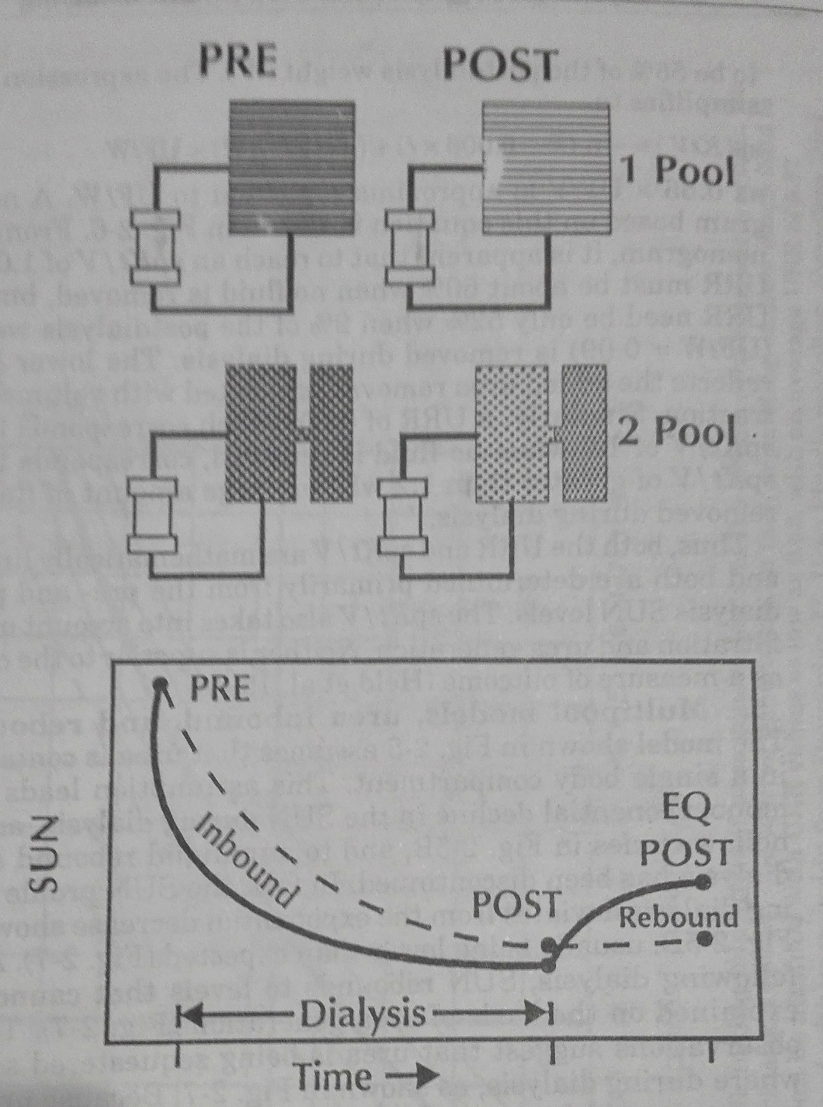
The 2-pool Kt/V model Urea is more rapidly removed from ECF

Slide 17
The 2-pool Kt/V model Urea is more rapidly removed from ECF

Slide 18
The 2-pool Kt/V model Urea is more rapidly removed from ECF
Immediate post-dialysis urea overestimates KT/V by apx 0.2
Equilibrated KT/V:
Obtain post sample 1 hr after dialysis ?
Use correction formula
NB A-V gradient for urea occurs during Dx when using AV access where arterial blood has lower conc up to 2 min post Dx

Slide 19
KT/V TARGETS
1.2 is the minimum acceptable
1.4 is the desirable target
Based on Sp KT/V and 3x/wk schedule

Slide 20
Case #1
M.H. is 6 y old (16Kg) on regular HD.
Predialysis serum creatinine is 5mg/dL, Urea 80 mg/dL, Bicarbonate 21 mmol/L, Hb 8
and postdialysis urea 35 mg/dL.
The father is insisting the child is now better and it is in his best interest to shorten dialysis from 4 to 3 hrs.
Do you agree?

Slide 21
Case #1
On a 4 hr session:
- He has a URR 56%, uF 1000mL

Slide 22
Case #1
On a 4 hr session:
- He has a URR 56%, uF 1000mL, KT/V of 1.0
- He is underweight and wasted
- He has poorly controlled anemia
He is asking for reducing session time
Do you agree?

Slide 23
PD ??
In nephrology, adequacy first used to describe an appropriate dose of HD
Adequacy for peritoneal dialysis adopted later
Conceptual overall goal equivalent to HD,
calculations not equivalent
Quite similar to native renal clearance calculations

Slide 24
PD
Renal clearance: UxV/P
Or Urine urea conc x Urine volume / plasma urea concentration

Slide 25
PD
Renal clearance: UxV/P
Or Urine urea conc x Urine volume / plasma urea concentration
Dialysis clearance: DxV/P
Or D/P ratio x Dialysate drain volume

Slide 26
PD: weekly KT/V
D/P ratio (urea)
X Dialysate volume per day = K
X 7 days =KT / TBW = KT/V
Add native kidney clearance
Minimally acceptable: 1.7-1.8
Desirable target: 2.0
+ Weekly creatinine clearnce 50L/ 1.73m2 ?

Slide 27
PD: PET
Measurement of equilibration (D/P ratios) of solutes
To assess membrane function (blood/ dialysate transport)
Steps:
Drain to dryness
Standard fill (2L or 40 mL/Kg, 2.27% glucose)
Sample dialysate at 0,2,4hrs, & plasma (assumed constant)

Slide 28
UF correlates with 4-hr D glucose and negatively with D/P creatinine

Slide 29
Values of PET
Peritoneal membrane transport classification
Predict dialysis dose
Choose peritoneal dialysis regime
Monitor peritoneal membrane function
Diagnose acute membrane injury
Diagnose causes of inadequate ultrafiltration
Diagnose causes of inadequate solute clearance
Estimate D/P ratio of a solute at a particular time

Slide 30
A very restrictive summary
Do PET & clearance after 6w, repeat clearance q6Mo:
Transport is related to target dwell time (high=fast)
Dialysis dose shall depend on dialysate volume when time is optimum
Consider volume tolerance (vs ++runs)

Slide 31
Case #2 IS THAT OK?
A.S. is two yrs old, 10 Kg weight on CAPD with 4 exchanges per day of 400 mL each. She is still passing urine & has the following lab results:
Blood Urea 90mg/dL Creatinine 4mg/dL
Dialysate drained 1800mL
Dialysate Urea 80mg/dL Creatinine 3mg/dL
Urine volume 200mL
Urine Urea 100mg/dL Creatinine 8mg/dL

Slide 32
Case #2 IS THAT OK?
10 Kg ➔ V=6000 mL
D/P Urea= 80/90
K= 80/90X1800=1600mL/day
Weekly KT=1600X7=11200mL

Slide 33
Case #2 IS THAT OK?
10 Kg ➔ V=6000 mL
D/P Urea= 80/90
K= 80/90X1800=1600mL/day
Weekly KT=1600X7=11200mL
Urine urea Cl =100X200/90=222mL/day
=1554mL/wk
Total KT=12754mL
Weekly KT/V=2.13 OK

Slide 34
Case #2 CREAT?
10 Kg ➔ V=6000 mL
D/P Crea= 3/4 ➔ K= 3/4X1800=1350mL/day
Weekly Cl=1350X7= 9450mL
Urine crea clearance=8X200/4=400mL/day
=2800mL/wk
CCl=12.25 L/wk
BSA= 0.47 ➔ CCl= 45L/wk/1.73m2

Slide 35
ADEQUATE DIALYSIS?
KT/v is based on urea (Mwt 60)
Adequate fluid control
MMwt clearance (role of convection)
Minimization of dialysis- associated morbidities

Slide 36
Fluid control: dry weight
The goal is to render pt euvolemic
With intermittent fluid removal on HD, tolerance of extra fluid removal becomes an issue (uF vs refill)
Was defined as the lowest post Dx weight a patient can tolerate without the development of symptoms or hypotension !!
Henderson LW; 1980

Slide 38
BVM
Rapid/ excessive drop ➔ too rapid uF
No (<5%) change in bl vol ➔ more to remove
Progressive decline (max 8% 1st hr, 4%/h, 16% total) ➔ OK
+ve refill ➔ more to remove

Slide 39
Fluid control: assessment
Clinical
Evidence of overload (HTN, oedema, ..)
Silent (subclinical) overload
Dialytic hypotensive episodes
Dehydration, hypovolemia
Supplemental tools
CVP, IVC, Bioimpedance, BVM
Change: ++ dry wt with Growth, with ++ in muscle/fat with ↓ uremia

Slide 40
ACUTE CRITICAL CASES
Fluid control may be the most important indication/ target
Correction of electrolyte-acid/base also required
MMWT (eg cytokines) clearance could help
High small MWT clearance is important in hypercatabolic patients
Hemodynamic instability commonly a concern
Achieving KT/V recommended for chronic dialysis has little relevance in critically ill patients

Slide 41
ACUTE DIALYSIS: The options
Acute P.D.
Conventional acute H.D.
SLED
CRRT

Slide 42
 | APD | AHD | SLED | CRRT
Solute Clearance | ++ | ++++ | +++ | + CVVH ++ HDF
MMWT Clearance | Variable | Minimal except oHDF |  | Yes α HF volume
Fluid Removal | Variable | Rapid | Slow | Slow
Control of outcomes | + | ++ | ++ | ++
Physio-logical? | ++ | + | ++ | +++
Cost & difficulty | Minimal | Mod | As HD + longer | High

Slide 43
Case#3
N.M., a 10-yr old (20 Kg) boy first presented with bilateral atrophic kidneys
Serum creatinine 13mg/dL, urea 280mg/dL, K 7mmol/L, pH 7.1, HCO3 6mmol/L
He will be dialyzed using a blood flow of 100ml/min on a dialyser with urea clearance of 80ml/min for that flow
How long should the first dialysis session be given that he is estimated to need to remove 1000 mL of fluid during dialysis?

Slide 44
First dialysis & disequilibrium
Target urea reduction 30%-40%
Mostly equals KT/V of 0.4-0.5
Knowing V (=TBW) and K (dialyzer and blood flow), calculate session time

Slide 45
Case#3
V= 20x 0.6 = 12 L
K= 80 mL/min
For KT/V= 0.4
80x T / 12000 = 0.4
T= 60 min.
But UF should take longer !!!

Slide 46
Adequacy is a concept, not just a number
In a narrow sense, adequate small MWT solute clearance
More broadly
Fluid status - Acid-base
Mineral metabolism
Middle MWT
Nutrition, anemia, growth & activity
Long-term outcomes
How the patient feels

Slide 48
Adequacy is a concept, not just a number
The optimum measurement of adequacy is not yet there !!!
Use available measurements
and Consider the patients’ overall condition

Slide 49
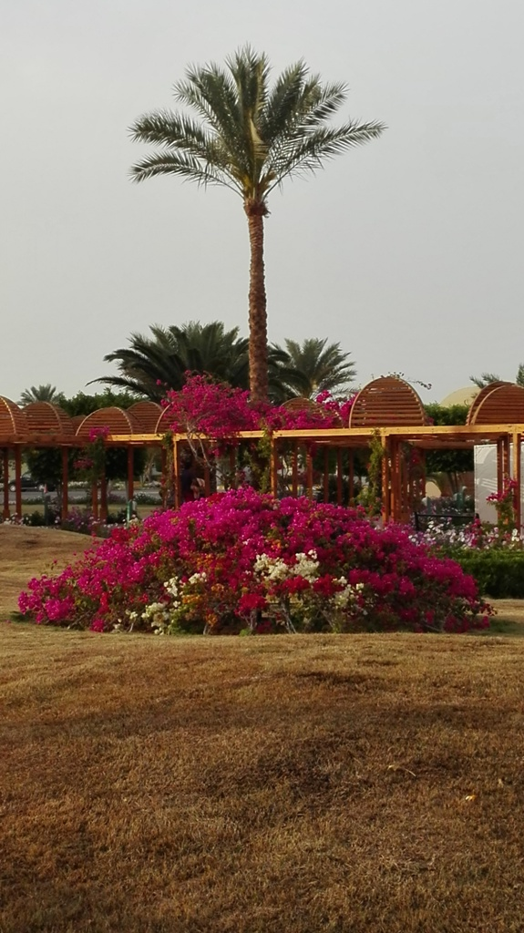
T
H
A
N
K
Y
O
U

